Slide 1
Requirement 4.3 ‘Key Teaching Tasks’
Notes:
Welcome to the short guide to illustrate how Requirement 4.3 Key Teaching Tasks can be approached and considered as part of your programme development presentation. I’m going to walk you through this step by step.

Slide 2
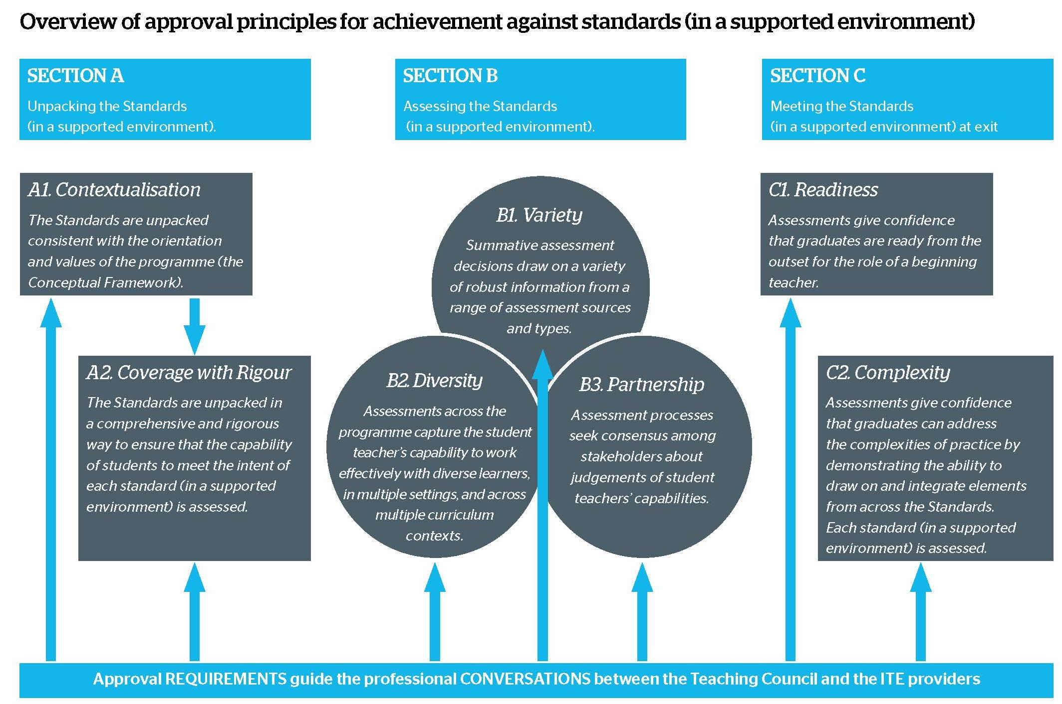
Notes:
The Key Teaching Tasks are an important element of the Assessment Framework.
It’s the element of the Framework which links to the principle of READINESS – see principle C1.
The next slides will discuss the Key Teaching Tasks in more significant detail, and show how they can connect to other Assessment Framework elements.
.

Slide 3
Notes:
Although the Assessment Framework can first appear as a ‘left to right’ linear model, it’s better understood as a multi-dimensional model, with the different principles interrelating in various ways. The Key Teaching Tasks are an ideal way to illustrate this.
The Key Teaching Tasks represent an approach to student assessment that’s distributed across the programme, yet still aligned to the Standards – you can see Section A of the Assessment Framework for more details.
Key Teaching Tasks also draw simultaneously upon the principles of Section B by integrating and expressing the principles of Variety, Diversity and Partnership.
Key Teaching Tasks also have connections to the Culminating Integrative Assessment – this will be discussed shortly.

Slide 4
“In addition to 4.1, the assessment framework must contain:
a set of at least 10-15 key teaching tasks that graduates from the programme can be entrusted to be capable of carrying out as a beginning teacher on day one on the job;
an explanation of how the key teaching tasks connect to the Standards; and
an explanation of how student teachers will be assessed on their mastery of the key teaching tasks.”
Notes:
From page 35 of the ITE Programme Approval Requirements, you will see the actual requirements for the Key Teaching Tasks.
On pages 11 to13 of Appendix 2 there’s more detail about how the Key Teaching Tasks can be framed against the Standards, and how they can be explained as progressions of professional task mastery.
The tasks themselves are observable and measurable, and describe student teacher actions that derive from the integration of knowledge, understanding and behaviour.
The Key Teaching Tasks capture essential aspects of practical, professional teaching work – they are therefore high priority in the sense that they represent the aspects of work that a beginning teacher needs to have established mastery in - with independence when they enter the profession.

Slide 5
The ‘Tight’ | ‘The Loose’
KTT should be observable and measurable | No set number of KTT
KTT should link directly to the Standards, with adequate coverage against all Standards | Students can achieve mastery of KTT over time within the programme.
KTT should directly link to practical, direct work with learners | No stipulation how or where KTT assessed.
Partners must be involved in the identification of KTT, and integration in programme design | KTT can be sector-specific
Other principles of the Assessment Framework should be evident in KTT – such as adherence to Diversity. | How KTT fit within professional placements is determined by ITE provider and professional partners.
(see Requirements document for more details) | (see Requirements document for more details)
Notes:
The Assessment Framework has been intentionally designed with a “Tight by Loose” orientation - this orientation is visible within the Key Teaching Tasks.
The ‘Tightness’ is the assessment integrity aligned towards the principle of Readiness
The “Looseness” is the sheer variety of approaches towards Key Teaching Tasks which can fulfil that Readiness principle.
Regarding ‘Tightness’…you’ll see the table shows there are some factors which should be observed. A key aspect is the necessity for the Key Teaching Task to be oriented towards teacher behaviour – rather than teacher skill or disposition.
For example, it is possible to observe a teacher de-escalating a situation in which a student is angry and may be at risk of harming other students. But conversely, it is not directly possible to observe a teacher having a commitment to her/his own professional learning. Look at the Requirements for more detail about this.
Regarding ‘Looseness’…First, the Key Teaching Task is not a single assessment, but a collection of events where students can progressively show mastery. This may be over the duration of the programme.
How, when, where, and with who this mastery is illustrated will be unique to each programme. These teaching tasks will be decided upon through close collaboration with partners, creating further opportunities for unique and diverse approaches.
So in summary, observing the ‘Tight but Loose’ principle will be valuable in the design of your programme’s Key Teaching Tasks.

Slide 6
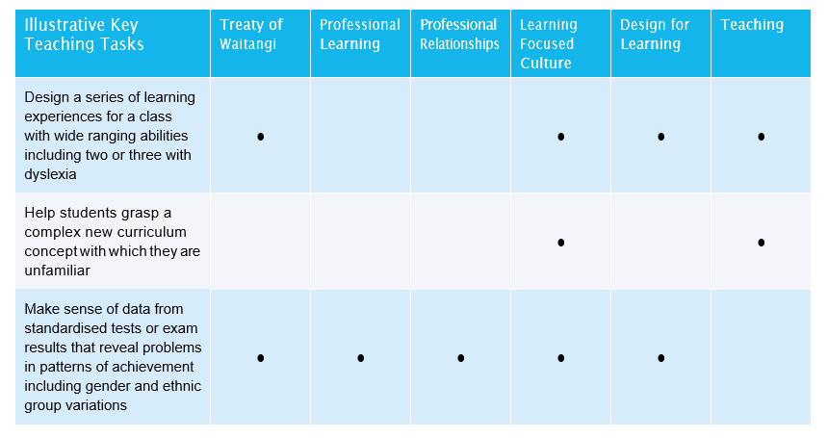
Notes:
On this sample grid you will see mapping examples of the Key Teaching Tasks against each Standard from page 12 of the Requirements, Appendix 2.
In this example, it shows that there are at least 11 Key Teaching Task assessment events across the programme. Following the same example, the first assessment event covers four of the six professional Standards. This in itself is not a problem as other Key Teaching Tasks create coverage across all the Standards.
This illustrates the A2 ‘Coverage with Rigour’ principle being utilised in the Key Teaching Tasks.

Slide 7
Notes:
The Key Teaching Tasks do not replace the Standards, but represent the Standards in observable, measurable critical professional tasks. As such, it’s important that there is recognisable coverage of the six Standards across the 10 to 15 Key Teaching Tasks.
Following on from the last slide, we’ve raised the connection of the Key Teaching Tasks (C1 Readiness principle), to the principle of ‘Coverage with Rigour’ – principle A2.
It’s important to recognise that the principles of ‘ Coverage with Rigour’ and ‘Contextualisation’ actually belong as a pair in this context – A1 and A2. The Requirements document recognises that the unique Conceptual Framework of each programme is an expression of that provider and the community which it serves. This contextualisation will be a ‘lens’ through which the programme views the Standards and how they are expressed and assessed.
Putting everything together, it can therefore be seen that the Key Teaching Tasks are drawing upon the Standards as recognised by that programme and community.
.

Slide 8
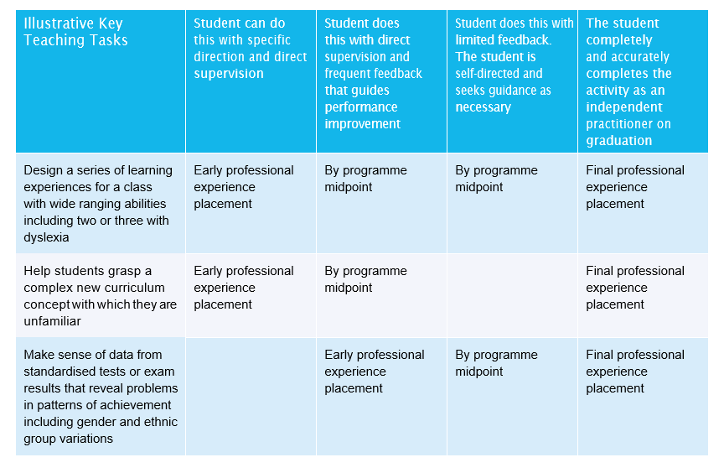
Notes:
This sample grid, mapping examples of key teaching tasks against each Standard’s is from page 12 of the Requirements, Appendix 2. It’s a good indication of how Key Teaching Tasks can be arranged in time so that a student has repeated opportunities to build mastery of what may initially be challenging professional tasks.
Independent mastery is not expected to be evidenced outright early in the programme - instead, the table shows how the earliest exposure to those tasks will be done with specific direction and direct supervision. Progressively over time, the programme will give repeated exposure of that student to those same tasks, but with increasing opportunity to take greater responsibility for the successful completion of that task.
Ultimately, all Key Teaching Tasks will need to be evidenced in assessment events as being completed accurately and independently.
Indirectly, it also shows how students within Initial Teacher Education’ programmes are not expected to show command of the Standards in isolation - instead they demonstrate this in alliance with professional colleagues – that is, ‘In a supported environment’.

Slide 9
Key Teaching Tasks and Partnerships
Notes:
As we’ve seen, the C1 Readiness principle connects in different ways to all the other key principles of the Assessment Framework. That said, the B3 Partnership principle has a particularly strong alliance with the C1 Readiness principle which is represented by the Key Teaching Tasks.
Why is this?
The inclusion of the Key Teaching Tasks in the Assessment Framework is partly at the request of the profession, who’ve asked for certainty in graduates being able to show mastery of critical professional tasks as beginning teachers. This then is an indication of how well suited partners are to the identification and construction of Key Teaching Tasks – as well as the possibility of being involved in the assessment of the tasks.
Involvement of partners and professional practice sites should be at the level of collaboration, not consultation. This means that rather than being asked to give opinions about decisions already made, partners are genuinely involved as early as possible. True consultation gives the best opportunity to build sustainable and robust understandings about the Key Teaching Tasks, and how each partner is responsible.

Slide 10
Connecting the Key Teaching Tasks with Diversity
Notes:
Some of the greatest demands in the life of a teacher arises from the diversity inherent in the teaching role.
Not only is the ‘typical learner’ more difficult to identify in each passing year, but so too, as research increasingly uncovers the needs that diverse learners can bring to the classroom, expectations upon teachers naturally increase.
This then emphasises the importance of integrating the principles of C1 Readiness with B2 Diversity, leading to Key Teaching Tasks which meet the needs of today’s diverse educational landscapes.
Once again, partners will be a key resource in the identification of Key Teaching Tasks which show commitment to diversity.

Slide 11
Connecting the Key Teaching Tasks with the Culminating Integrative Assessment
Notes:
The Key Teaching Tasks make another connection within the Assessment Framework which should be observed.
The C2 Complexity principle is upheld by what is known as the Culminating Integrative Assessment. This is an assessment near graduation, which asks a student to bring together the totality of their capacities, skills and knowledges, against the context of an authentic practice problem.
If the Key Teaching Tasks have been well identified, they should have recognisable connections to the Culminating Integrative Assessment – that is, the teaching challenges that Key Teaching Tasks seek to address will almost inevitably be discussed in that integrative assessment.
So too, independent mastery of the Key Teaching Tasks will probably be evident and discussed in the context of the integrative assessment – and may possibly be revealed as parts of the solution which the student will be expected to have found.
.

Slide 12
So, what might Key Teaching Tasks look like?
Design a series of learning experiences for a class with wide ranging abilities including two or three with dyslexia.
Help students grasp a complex new curriculum concept with which they are unfamiliar.
Make sense of data from standardised tests or exam results that reveal problems in patterns of achievement including gender and ethnic group variations.
Carry out a running record for a learner whose current reading level is unknown, and who has expressed reluctance to read.
Give feedback to a group of students when you have noticed from listening to their talk, several conceptual misunderstandings from some of the group, that you have previously attempted to clarify with the whole class.
Welcome a new child and her/his whānau to a setting who has become upset on arrival.
Notes:
It is important to note that while some of these tasks may be common across sectors, there will always be some key teaching tasks which relate particularly to some sectors more than others.
Page 13 of Appendix 2 gives some good examples of what the Key Teaching Tasks could look like – but it’s important to remember that organisational context, partnerships, and sector type can shape the tasks for particular programmes.
You will see some tasks on this slide, make your own judgement if they each meet the criteria for Key Teaching Tasks – that is, are they:
observable, measurable?
aligned to individual Standards, or possibly groups of Standards?
directly linked to practical, direct work with learners?
(Each KTT is animated – click and read each KTT in turn)

Slide 13
Notes:
This concludes our slide presentation of the Key Teaching Tasks.
Please be sure to view the other videos in this series, to understand how different elements of the Assessment Framework fit together.
For more assistance with the Key Teaching Tasks, or any other aspects of the new Initial Teacher Requirements, please contact your organisation’s designated Teaching Council ‘Lead Advisor’.
(Add in slide with LA photos and contact details)
.

