Slide 1
Requirement 4.2 Culminating Integrative Assessment
Notes:
Welcome to this short presentation illustrating how Requirement 4.2 Culminating Integrative Assessment can be approached and considered.

Slide 2
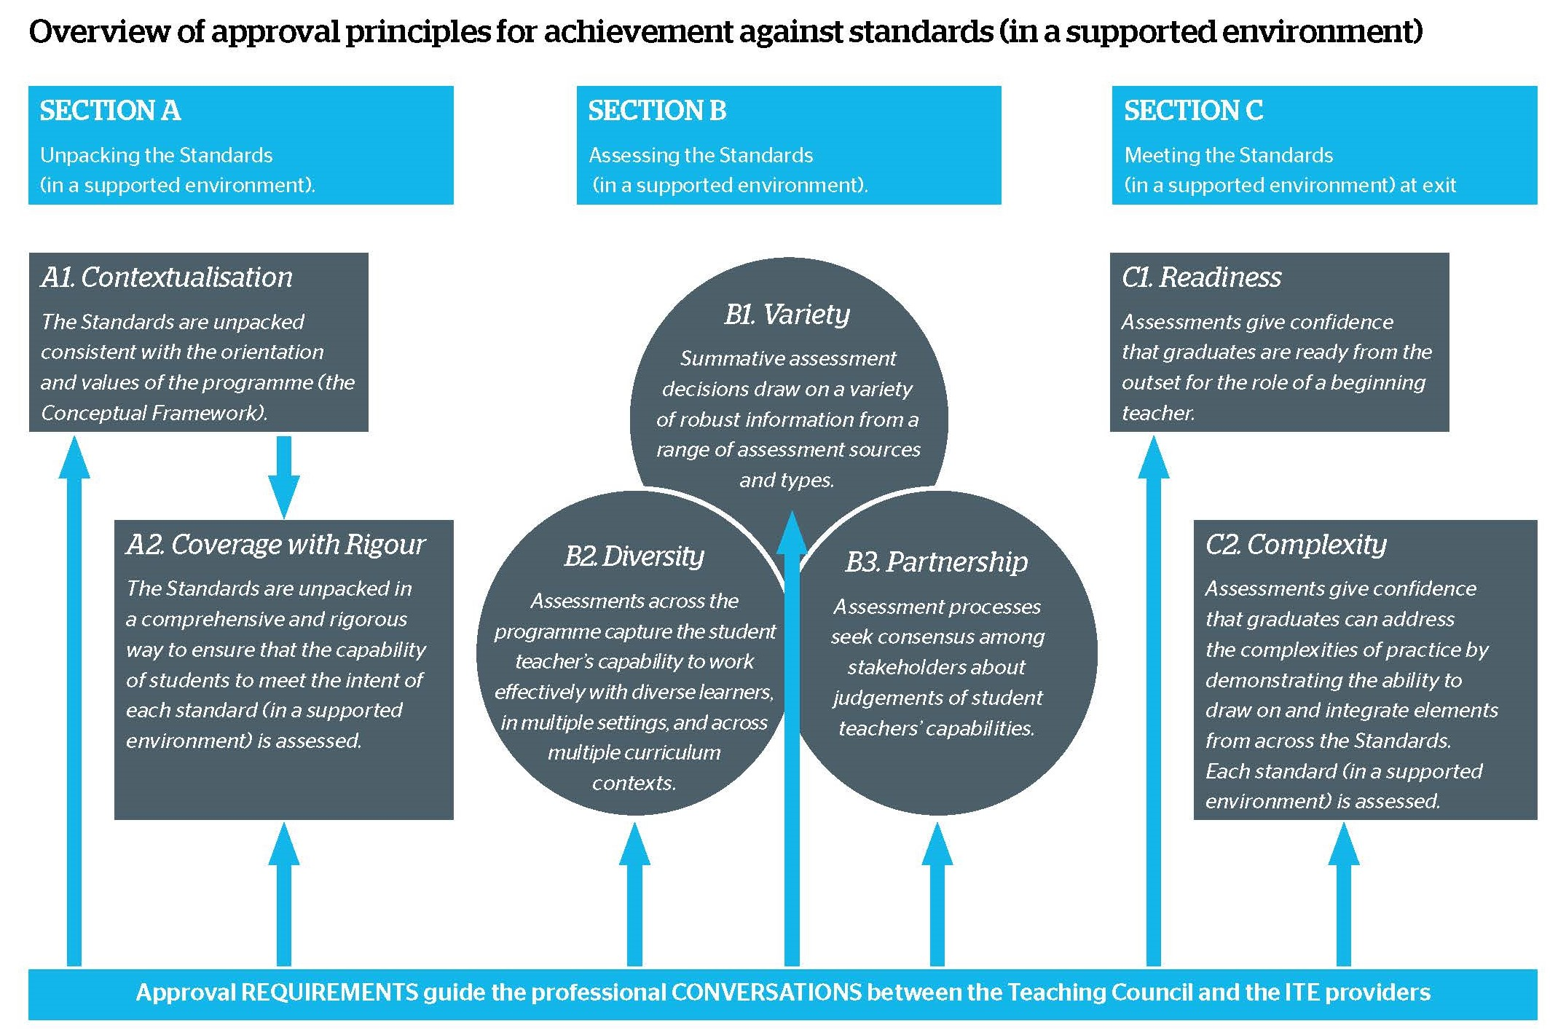
Notes:
The Culminating Integrative Assessment is a single, but important part of the Assessment Framework.
It is the element of the Framework with responsibility for the principle of COMPLEXITY – Principle C2
Most of the in-the-moment and planned decisions that teachers make are complex because they require the teacher to draw on multiple sources of information and to integrate knowledge and skills that relate to more than one Standard.
While the integration of elements of the Standards Ngā Paerewa will be a feature of assessments across the programme, the full integration of the student teachers’ learning can only be comprehensively assessed towards the end of the programme – this is the unique contribution of the Culminating Integrative Assessment.

Slide 3
Notes:
This assessment is a valuable opportunity to assess student’s ability to access and integrate multiple sources of knowledge and skills to address problems of practice.
The Culminating Integrative Assessment requires student teachers to apply the knowledge, capabilities and skills they’ve learned during their programme to an authentic situation(s) that relates closely to the professional work of teachers in the sector for which they’re being prepared.
As part of this process, student teachers will also be able to explain the connections of their actions and decisions to the Standards Ngā Paerewa.
Although the Assessment Framework can initially appear as a linear model, the elements all interweave fluidly, both within time and across time. The Culminating Integrative Assessment has explicit and implicit connections to all other parts of the Assessment Framework – which will be explained further in this presentation.

Slide 4
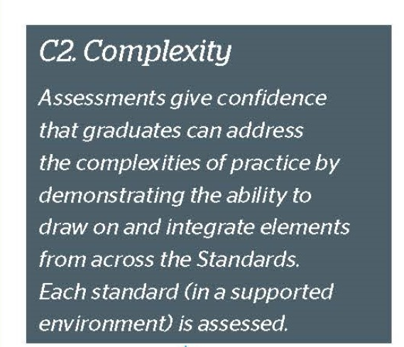
“In addition to 4.1, the assessment framework must contain a culminating integrative assessment that assesses whether a student teacher is able to effectively integrate theory and practice, and synthesise their learning across the Standards. This assessment will need to:
be undertaken towards the end of the programme;
have credit-value;
be based on an open-ended authentic practice situation(s) that requires complex decision-making and the synthesis of learning from across the programme;
build on other assessments through the programme to help enhance provider judgement that a student has met the Standards and as such, is ready to teach; and
be presented orally, or primarily orally with a written element.”
Notes:
From page 32 of the ITE Programme Approval Requirements, we can see the actual requirements for the Culminating Integrative Assessment.
As you will see, the emphasis is upon the student teacher being able to effectively integrate, illustrate and express their command of the Standards at a focus point towards the end of the programme.
This assessment needs to actually sit within a course of study, hence it requires credit value – but the credit value is at the discretion of the programme designers.
Although the Culminating Integrative Assessment probably stands alone as a single assessment event, it may be comprised of more than one assessment event if the programme designer can show that there’s coherency between the different events.
But as you saw in the last last slide, the Culminating Integrative Assessment can be considered the pinnacle assessment event of the entire programme. As such, the student’s learning and growth from each previous formative and summative assessment will probably have presence in some form or another. The Culminating Integrative Assessment is therefore not intended to stand in isolation, but to support and build upon the strength of effective assessment tasks elsewhere in the programme.

Slide 5
“Tight
but
Loose”
Some potential authentic practice situations could be:
drawn from the student teacher’s own description of a challenging practice situation they have faced on a professional experience placement;
an inquiry the student teacher has carried out based on a puzzle of practice that they have attempted to resolve;
a real, complex task that teachers typically need to complete such as a major piece of planning for a defined context or contexts (level, subject, student profile);
More potential examples on pages 33/44 of the Requirements document
Notes:
As you’ll see on this slide, the Requirements document gives some initial options for how an authentic practice situation could be created.
Besides these examples and others on pages 33 and 34 of the Requirements document, it’s quickly apparent that there are limitless options for the design of this assessment.
The Assessment Framework has been intentionally designed with a “Tight but Loose” orientation and this is visible again within the Culminating Integrative Assessment.
This will be discussed in more detail next, and will help to explain how there’s great flexibility in the design of the Integrative Assessment, provided that guidance from the Requirements document is observed.

Slide 6
The ‘Tight’ | ‘The Loose’
CIA must be held towards end of programme and have credit value | How closely CIA connects to specific practicum contexts
CIA must be based on an open-ended authentic practice situation | How partners are involved in the assessment of the CIA
CIA builds on other assessments throughout the programme | How multimedia may or may not be involved in CIA
CIA is presented orally, or primarily orally with a written component | Whether the CIA practice situation is from a students own practice situation, an inquiry, provided case study, a visual prompt, a posed problem, a role-play/simulation, or something else …
CIA assessment criteria and associated rubrics should observe advice fromthe Requirements document (p.34)
(see Requirements document for more details) | (see Requirements document for more details)
Notes:
The ‘Tightness’ is the assessment integrity aligned towards the principle of Complexity.
The “Looseness” is the sheer variety of approaches that can be used for the integrative assessment which can fulfil that Complexity principle.
Regarding ‘Tightness’…The table shows that there are some factors which should be observed and are described in more detail in the Requirements document, on pages 32 to 35.
Regarding ‘Looseness’ this is also described in those same pages. The assessment design has capacity to incorporate an ‘authentic practice situation’ in a huge variety of ways.
In summary, observing the ‘Tight but Loose’ principle will be valuable in the design of your programme’s Culminating Integrative Assessment.

Slide 7
Culminating Integrative Assessment and Partnerships
Notes:
As we’ve already seen, the C2 Complexity principle connects in different ways to all the other key principles of the Assessment Framework.
The B3 Partnership principle’s connection with the C1 Complexity principle represents one of the vital interconnections for the Culminating Integrative Assessment.
The Culminating Integrative Assessment is placed near the end of a programme as a student nears the point of graduation and transition to the profession.
This assessment gives the profession confidence that graduates have the proven capacity to negotiate the complexities, contradictions and dilemma’s faced in daily teaching practice. These complexities of practice are assessed through an authentic practice situation – this is a context that practitioners are well suited to advise upon.
Even if not directly involved with the assessment of the Integrative Assessment, partners may have voice in the different assessments that cumulatively prepare a student for the Culminating Integrative Assessment near the near of the programme.
In summary, before the design work of this assessment proceeds too far, it’s wise to draw upon the ideas and thinking of different partners. Although it’s unlikely that all partners will think uniformly about the demands of this Integrative assessment, there may be some useful patterns of approach which will inform the process and design.

Slide 8
Notes:
We’ve earlier discussed how the C2 Complexity principle connects in different ways with all other Assessment Framework elements.
Now we can take a brief look at how the Complexity principle connects simultaneously with the A1 principle of Contextualisation and the A2 principle of Coverage with Rigour.
The Requirements document has the expectation that the Standards assessment focuses for each programme will be interpreted through the lens of that organisation’s Conceptual Framework – this interpretive comprehension of the Standards is reflected in the Assessment Framework in the principle of Contextualisation – A1.
The A2 principle of Coverage with Rigour is responsible for the equitable distribution of Standards assessment throughout the programme – that is, that all Standards are being assessed with reasonable distribution across the entire assessment design.
Although the Requirements document does not absolutely stipulate that the Culminating Integrative Assessment assesses against all Standards, it’s probably fair to assume that it will – if the integrative assessment is an authentic complex practice situation, it’s likely that all of the Standards will be called upon and illustrated by the student within this assessment.
.

Slide 9
Connecting the Culminating Integrative Assessment with Diversity
Notes:
Some of the greatest demands in the life of a teacher arise from the diversity inherent in the teaching role. The ‘typical learner’ in Aotearoa New Zealand is increasingly more difficult to identify, as the student population becomes more diverse. As well, research is increasingly uncovering new understanding of the needs that diverse learner groups bring to the classroom.
The Culminating Integrative Assessment is built upon an authentic practice situation – this requires integrating the principles of C2 Complexity with B2 Diversity, leading to a Culminating Integrative Assessment which incorporates aspects of diversity within the assessment.
Within the ‘Tight but Loose’ orientation, the ‘tightness’ is that diversity needs to be inherent in the assessment – the ‘looseness’ is how this is done. Once again, partners to the programme may well be a valuable reference point for how that could be skilfully achieved.
Questions which the Diversity principle may ask of the Culminating Integrative Assessment design are:
Are the needs of diverse learners part of the assessments practice situation?
Are those learners at the margins of the assessment, or more centrally located?
Can knowledge of the needs of diverse learners also provide solutions for other students?

Slide 10
Connecting the Key Teaching Tasks with the Culminating Integrative Assessment
Notes:
The Culminating Integrative Assessment makes another connection within the Assessment Framework which is referred to in the Requirements document.
The C1 Readiness principle is upheld by what is known as the Key Teaching Tasks. The Key Teaching Tasks are a family of professional tasks which have been identified as critical to the core effective functioning of a practicing teacher.
In the context of Initial Teacher Education, the Key Teaching Tasks are those observable and measurable tasks directly linked to working with learners.
An effective Culminative Integrative Assessment will have recognisable connections to the Key Teaching Task. That is, the teaching challenges that Key Teaching Tasks seek to address will almost inevitably be discussed in that integrative assessment. So too, independent mastery of the Key Teaching Tasks will probably be evident and discussed in the context of the integrative assessment – and may possibly be revealed as parts of the solution which the student will be expected to have found.
.

Slide 11
Reflections upon the Culminating Integrative Assessment
How can the practice situation be decided upon, and how can it represent complex decision-making?
How can practitioners contribute to the design
and assessment?
How can the assessment criteria and rubrics effectively match the assessment demands of this particular assessment?
How can the moderation processes you prefer optimise consistency of judgement for the Culminating Integrative Assessment
Notes:
The questions presented here are a few of the deliberations which can be useful as the design of the Culminating Integrative Assessment is considered.
More useful questions will naturally arise as the design process begins and other assessment tasks begin to connect to the integrative assessment.

Slide 12
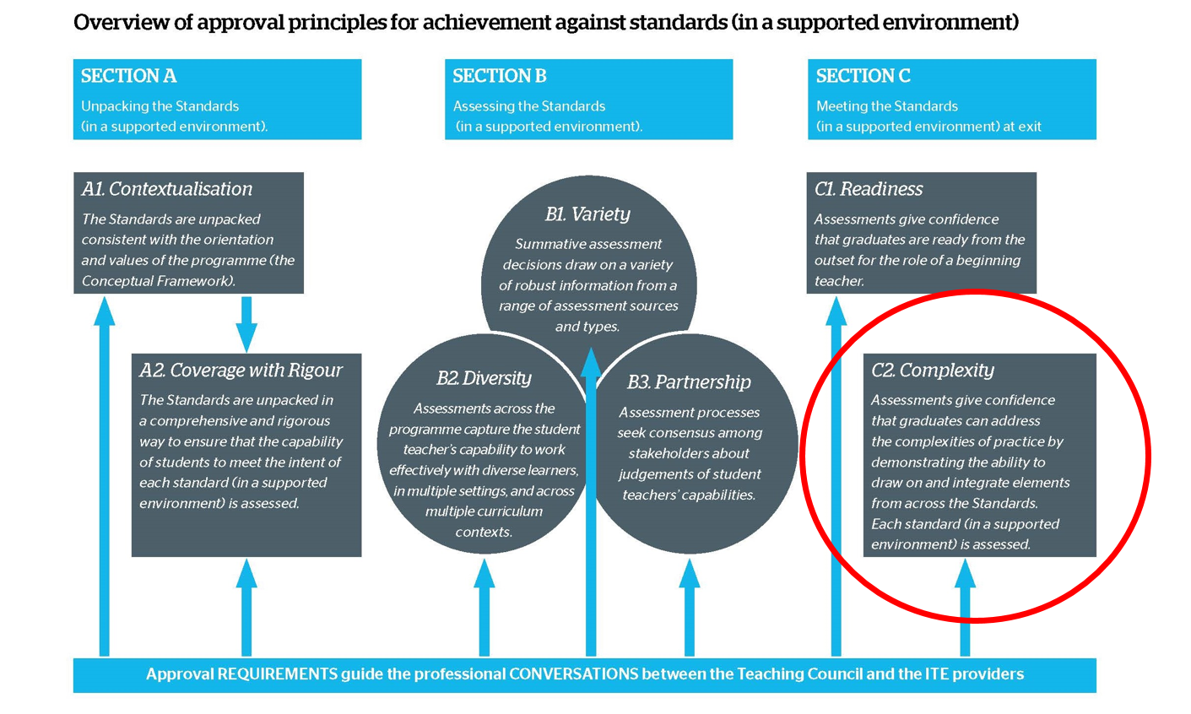
Culminating Integrative Assessment
Notes:
In summary, the Culminating Integrative Assessment is more than ‘just another assessment’.
This assessment is a unique opportuity for the student to demonstrate a thorough comprehension of the Standards, and a fluent capability to use them successfully in practice – for the betterment of learners.
We hope this presentation has provided some clarity. For more assistance with the Culminating Integrative Assessment, or any other aspects of the new Initial Teacher Requirements, please contact your organisation’s designated Teaching Council ‘Lead Advisor’.
(Note – to add – LA photos and contact)

